Slide 1
Movie’s Gross Earnings Correlation to Twitter Factors
Course: SI 330 Data Manipulation
Author: Jonathan Bracci

Slide 2
Objective
Use IMDB to find top 5 grossing movies and output into an html file
Parse html and output meta-data for each title into csv file
Look for correlation in amount of money earned against…
Imdb Rating
Imdb Votes
Year of Production
Tweet Polarity
Amount of Retweets

Slide 3
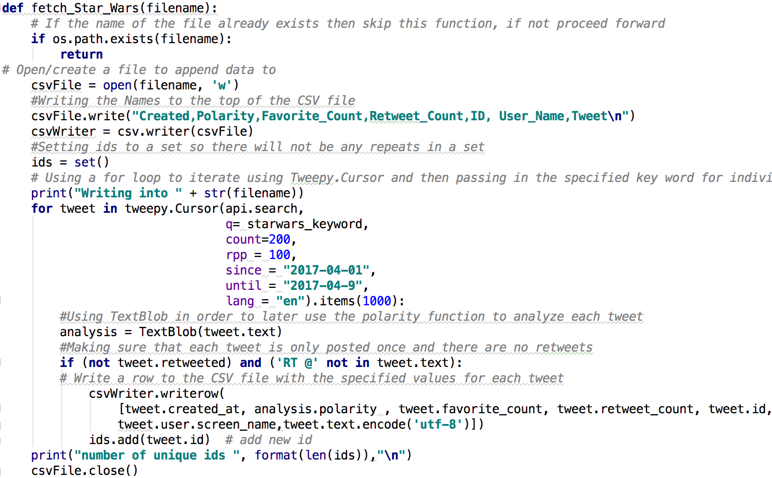
Objective – High Level Processing
Used Twitter API with Tweepy Module and TextBlob
Iterated through top 5 titles
Used movie title for key word search
Gathered …
Date of Tweet
Amount of Retweets
Polarity
Tweet

Slide 4
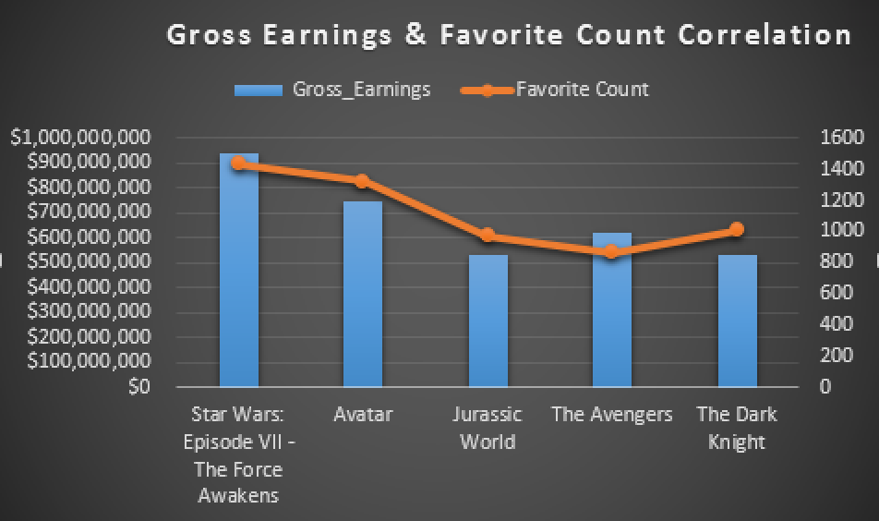





Significant Findings
Correlations

